Slide 1
Password Locker
Python Project
Presented by
Chandu S & Adithya A Bharadwaj

Slide 2
Introduction:
You probably have accounts on many different websites. It’s a bad habit to use the same password for each of them,
If any of these sites has a security breach, the hackers will learn the password to all of your other accounts.
It’s best to use password manager software on your computer that uses one master password to unlock the password manager.
Then you can copy any account password to the clipboard and paste it into the website’s password field.
This password manager program you’ll create in this example isn’t secure, but it offers a basic demonstration of how such programs work.

Slide 3
Modules Used
Pyperclip
Pyperclip is a cross-platform Python module for copy and paste clipboard functions. It works with both Python 2 and 3.
The pyperclip module has copy() and paste() functions that can send text to and receive text from your computer’s clipboard.
Sending the output of your program to the clipboard will make it easy to paste it on an email, word processor, or some other software.
Sys
The sys module in Python provides various functions and variables that are used to manipulate different parts of the Python runtime environment.
It allows operating on the interpreter as it provides access to the variables and functions that interact strongly with the interpreter.

Slide 4
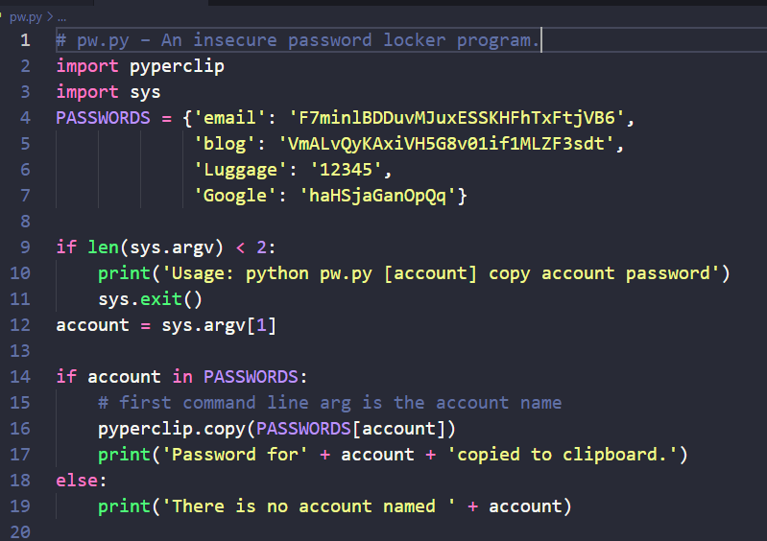
Source Code

Slide 5
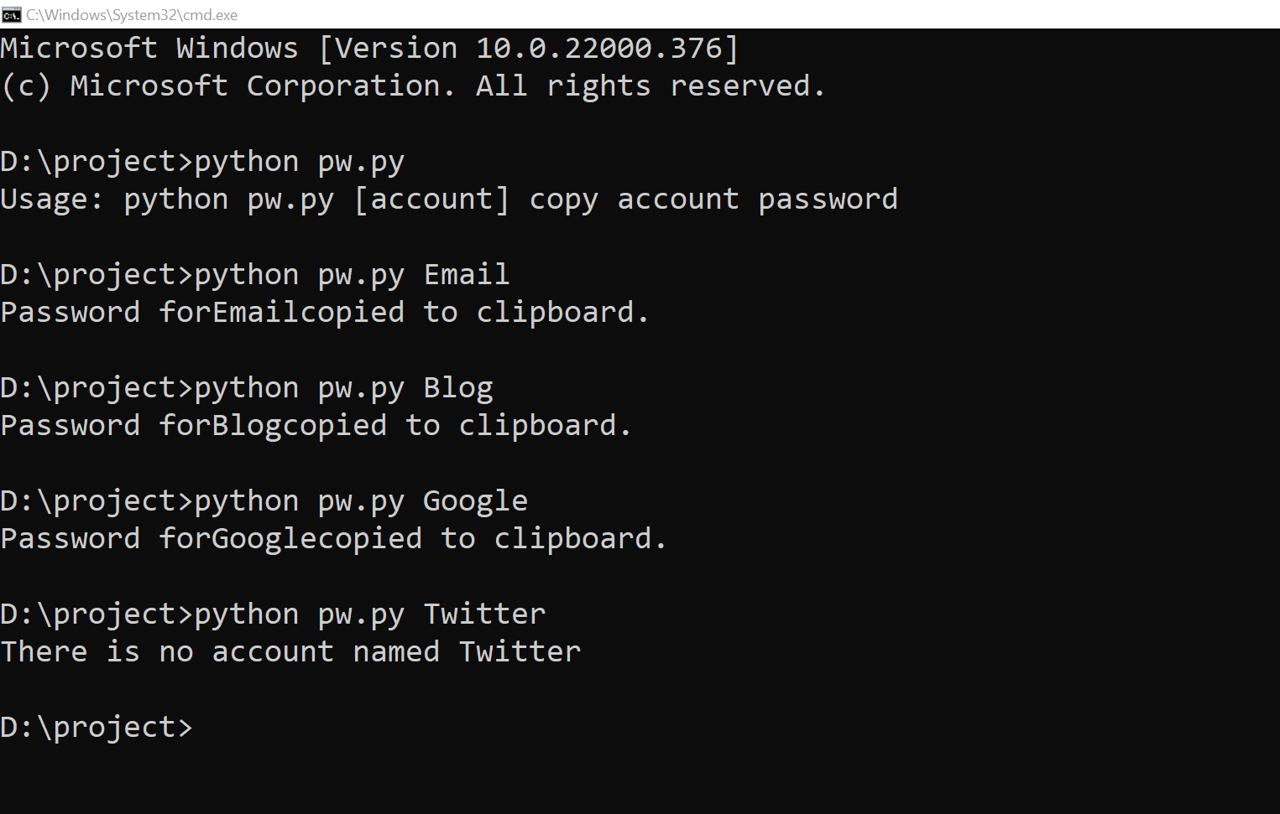
Output:

Slide 6
